Slide 1




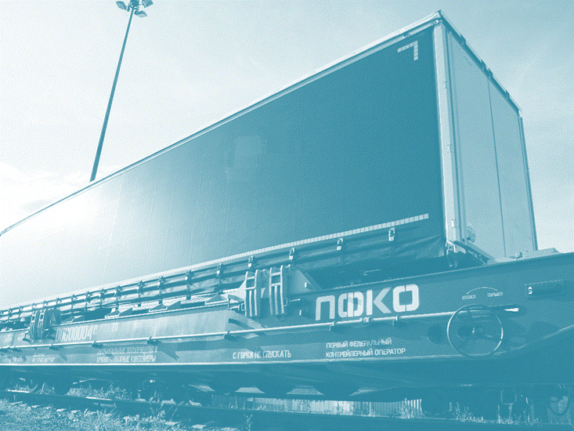
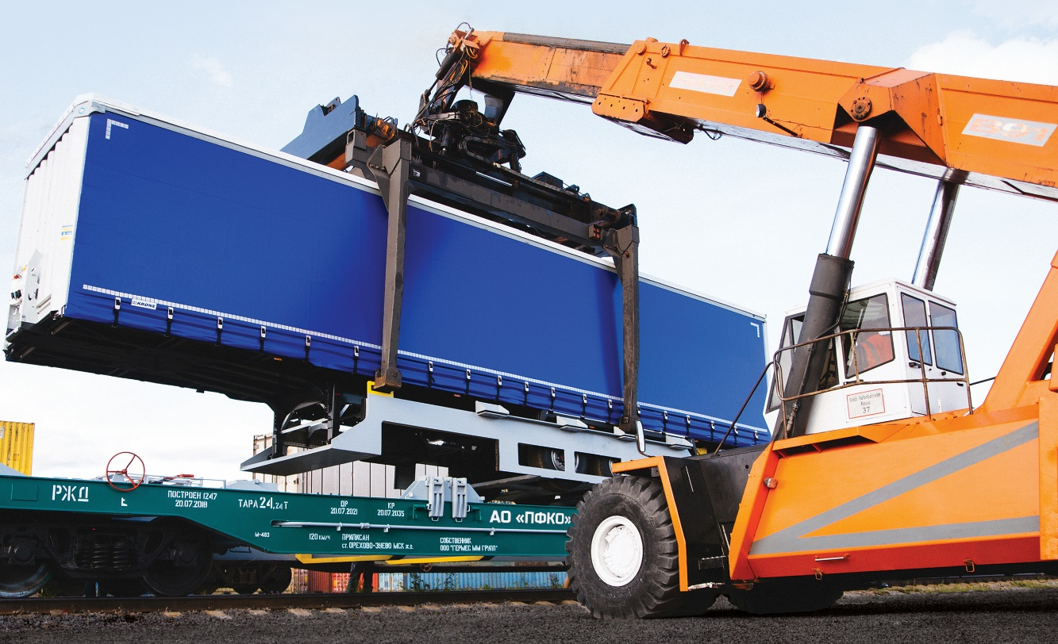
THE FIRST FEDERAL
INTERMODAL FREIGHT OPERATOR
RUSSIAN COMBINED TRANSPORT TECHNOLOGY SOLUTION
on EURASIAN ROUTES INTERMODAL SERVICE OF THE FUTURE
Moscow, 2020

Slide 2









BENEFITS OF COMBINED TRANSPORT TECHNOLOGY
IMPROVEMENT OF THE ECOLOGICAL SITUATION
DECREASE IN LEVEL OF ACCIDENT RATE,
AND MORTALITY ON ROADS
INCREASE IN SERVICE LIFE OF THE CAR
1
REDUCED LOAD ON THE ROADWAY
20 000
COMPARISON OF DAMAGE TO THE ROAD FROM 1 TRUCK AND CARS
INCREASE IN SIZE OF TRANSPORT UNIT
+ 25% in the volume of cargo

Slide 3
PFKO COMBINED TRANSPORT TECHNOLOGY
up to 14.2m
A flat wagon with the slot for special lifting carrying unit for semi-trailers is the
PFKO’s own design
19.5m
The main advantage of the PFKO technology –
NO RESTRICTION ON THE ENTIRE TERRITORY OF THE CIS
AND THE BALTIC COUNTRIES
POSSIBILITY OF TRANSPORTATION AS A PART OF ANY TRAIN

Slide 4
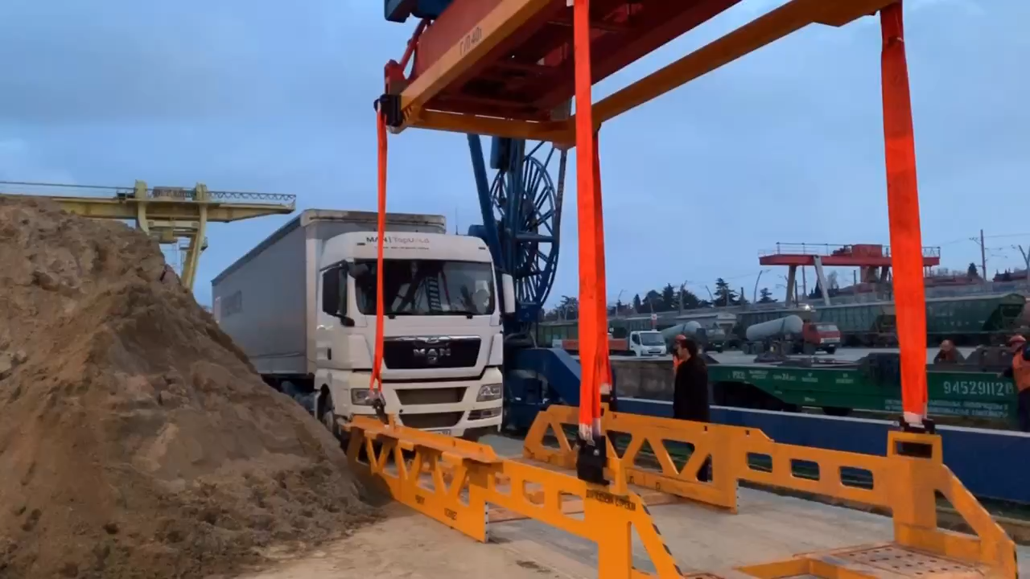

Slide 5







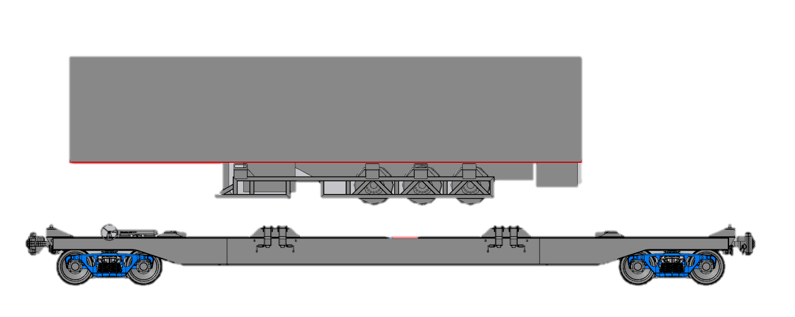
INITIATIVES OF COMBINED TRANSPORTATION PROMOTION
SPECIAL REDUCED RAILWAY RATES
GOVERMENT PROGRAM of SUPPORT and SUBSIDIZING
OPTIMIZATION OF THE LEGAL AND REGULATORY BASE
APPLYING UNIFIED CONSIGNMENT NOTE

Slide 6
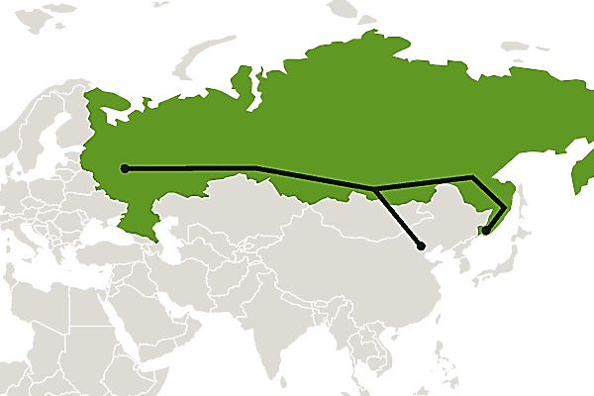




FFIFO’S GOALS FOR DEVELOPMENT CHINA-EUROPE TRANSIT ROUTE
DEVELOPMENT of the "SILK ROUTE“ INTRODUCING the COMBINED (piggy-back) TRANSPORTATION SERVICE;
DEVELOPMENT of the HIGH-SPEED CARGO TRANSPORTATION.
[faster transportation speed up to 100 km per hour, or 1000-1500 kilometers per day];
GROWTH OF THE CHINA – EUROPE TRADE TURNOVER
increased
1.5 times
within 10 years
EUROPE – RUSSIA – CHINA
TRANSIT TIME
12-14 days

Slide 7
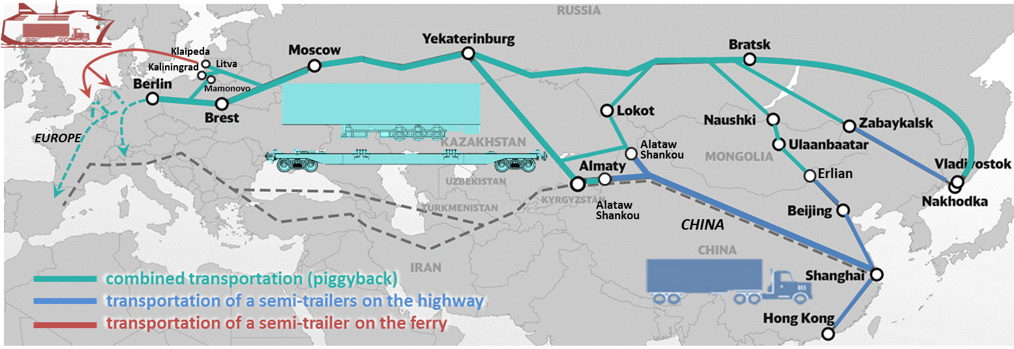
EAST-WEST COMBINED TRANSPORTATION
FASTER TRANSPORTATION SPEED
up to 100 km per hour
[1000-1500 kilometers per day]

Slide 8

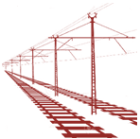

BENEFIT FOR ALL PARTIES
BENEFITS FOR the RAILWAY:
INCREASE IN CARGO TRANSPORTATION VOLUME AT RAILWAY NETWORK
GROWTH IN INCOMES FROM CARGOES WITH HIGH ADDED VALUE
DECREASE in MAINTENANCE COST
BENEFITS FOR the HAULERS:
DECREASE IN OPERATIONAL EXPENSES
GROWTH IN INCOME
ACCELERATION OF TRANSPORTATION PROCESS
BENEFITS FOR the COUNTRIES:
IMPROVEMENT OF THE ECOLOGICAL SITUATION
DECREASE IN LEVEL OF ACCIDENT RATE AND MORTALITY ON ROADS
REDUCED LOAD ON THE ROADWAY

Slide 9
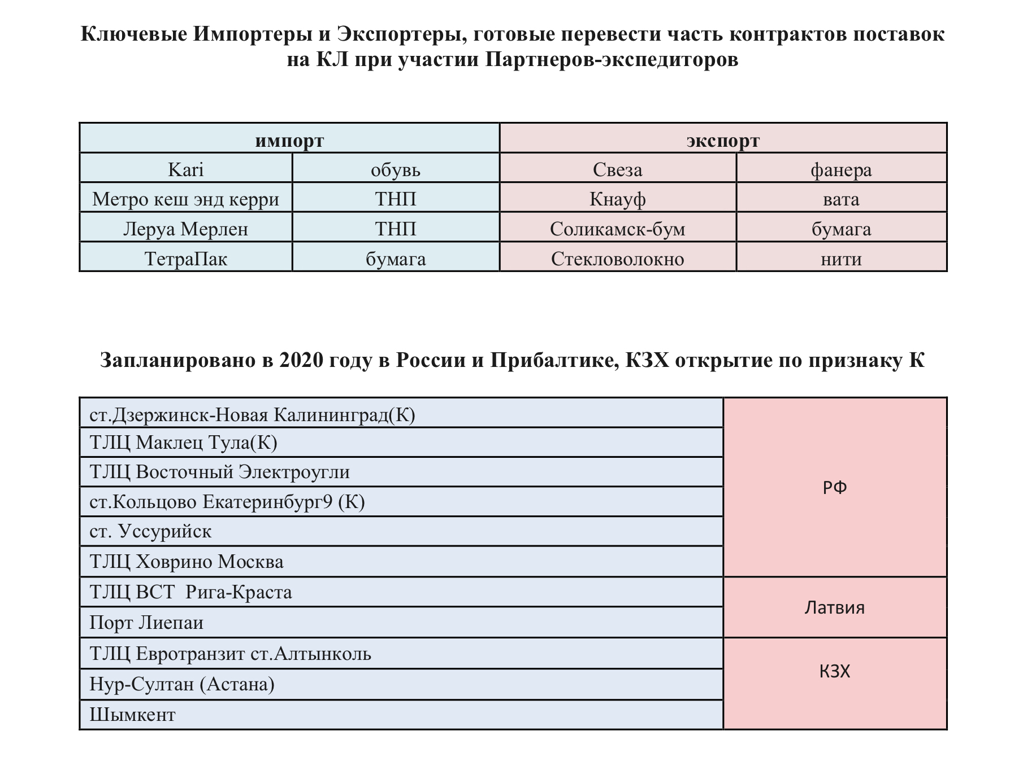

Slide 10
THE FIRST FEDERAL
INTERMODAL FREIGHT OPERATOR
Thank you!
Roman Vdovin
Managing Partner
JSC PFKO
vdovin@pfko.com
+7 925 307-72-30

